Slide 1
Co-opting of #SaveTheChildren
November 19, 2020
Analysis on the systematic co-opting of the hashtag #SaveTheChildren for nefarious purposes by the group QAnon
Presented by: Udith Prabhu
Presented for: CS795/895

Slide 2

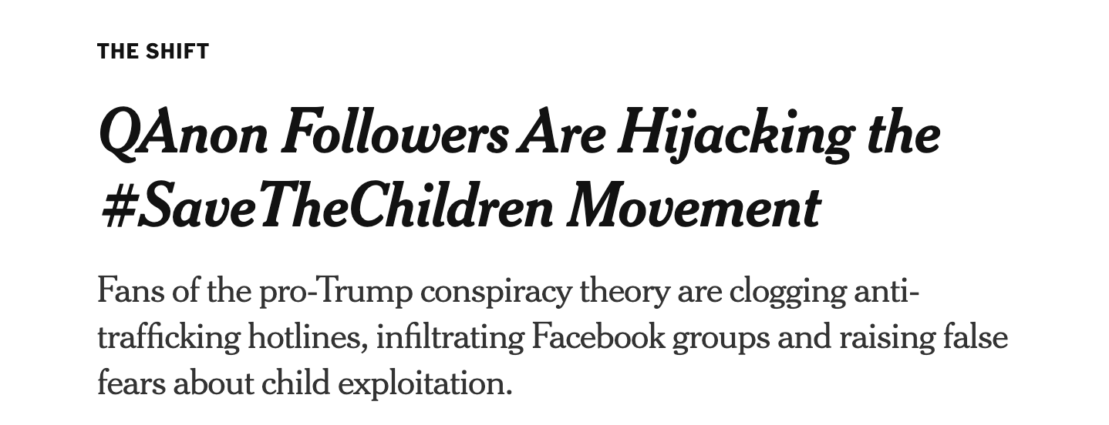
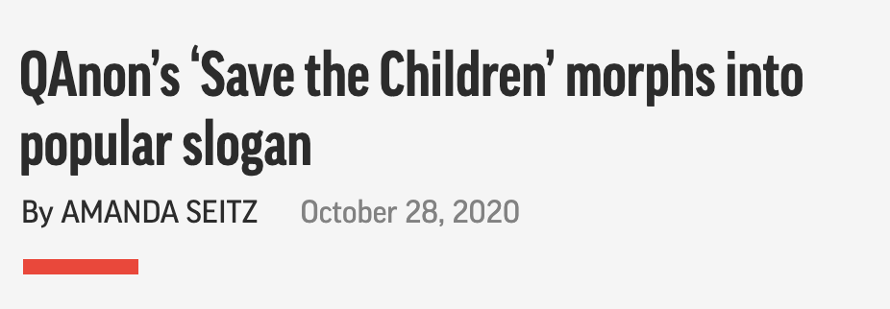

News on which the presentation is based
https://www.nytimes.com/2020/08/12/technology/qanon-save-the-children-trafficking.html
https://apnews.com/article/election-2020-donald-trump-child-trafficking-illinois-morris-aab978bb7e9b89cd2cea151ca13421a0
https://the1a.org/segments/qanon-save-children-facebook/
CS895 “Co-opting of #SaveTheChildren” a study by Udith Prabhu #cs895f20

Slide 3

‘Save the Children’ is a leading humanitarian organization
Found by Eglantyne Jebb and her sister Dorothy Buxton.
Was established in the UK in 1919, after World War 1.
Works in around 117 countries
Aim of the NGO is to gain more rights for young people.
https://www.savethechildren.org/
https://www.savethechildren.net/
https://en.wikipedia.org/wiki/Save_the_Children
CS895 “Co-opting of #SaveTheChildren” a study by Udith Prabhu #cs895f20

Slide 4

QAnon is an extreme right conspiracy theorists group
The group alleges that a cabal of Satan-worshipers is running a global child sex-trafficking ring.
The “cabal” is also allegedly plotting against President Donald Trump.
“Q” claims to be a high level government official with Q clearance level.
The FBI has identified QAnon as a potential domestic terrorist threat.
https://www.nbcnews.com/tech/tech-news/what-qanon-guide-conspiracy-theory-taking-hold-among-trump-supporters-n897271
https://en.wikipedia.org/wiki/QAnon
CS895 “Co-opting of #SaveTheChildren” a study by Udith Prabhu #cs895f20

Slide 5
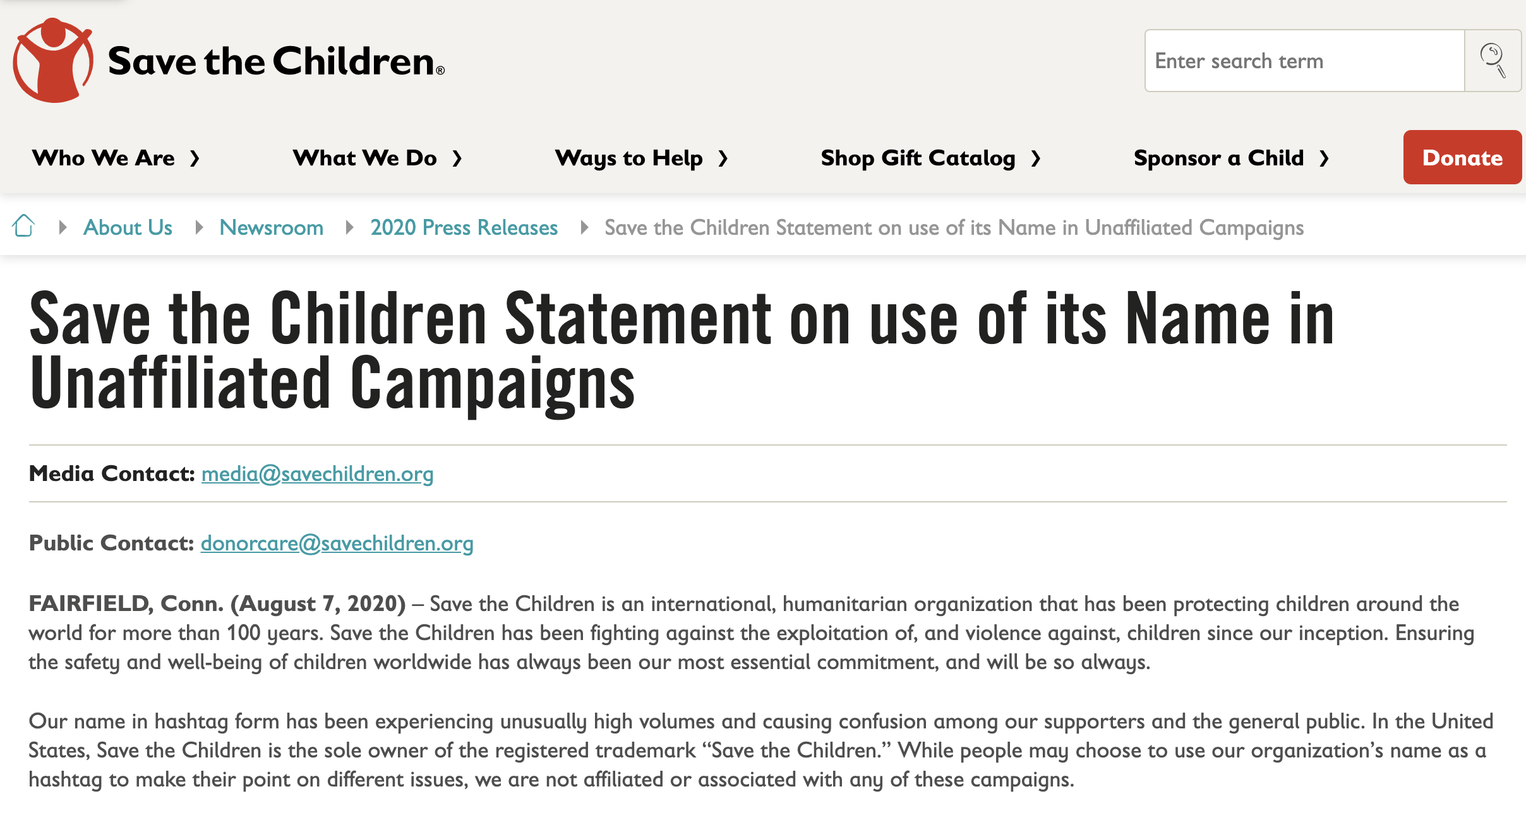
SaveTheChildren group released a statement after the co-opting of the hashtag by QAnon
https://www.savethechildren.org/us/about-us/media-and-news/2020-press-releases/save-the-children-statement-on-use-of-its-name-in-unaffiliated-c
CS895 “Co-opting of #SaveTheChildren” a study by Udith Prabhu #cs895f20

Slide 6
Hashtag Analysis - Facebook
CS895 “Co-opting of #SaveTheChildren” a study by Udith Prabhu #cs895f20

Slide 7
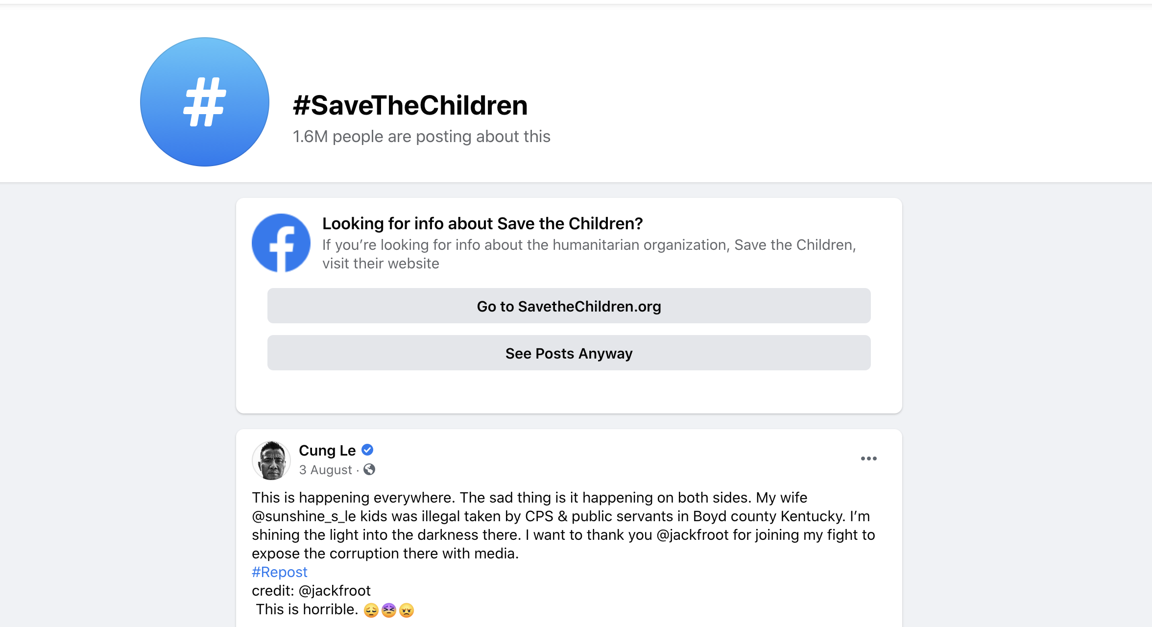
Facebook displays an info box to stop spread of misinformation
https://www.facebook.com/hashtag/savethechildren
CS895 “Co-opting of #SaveTheChildren” a study by Udith Prabhu #cs895f20

Slide 8
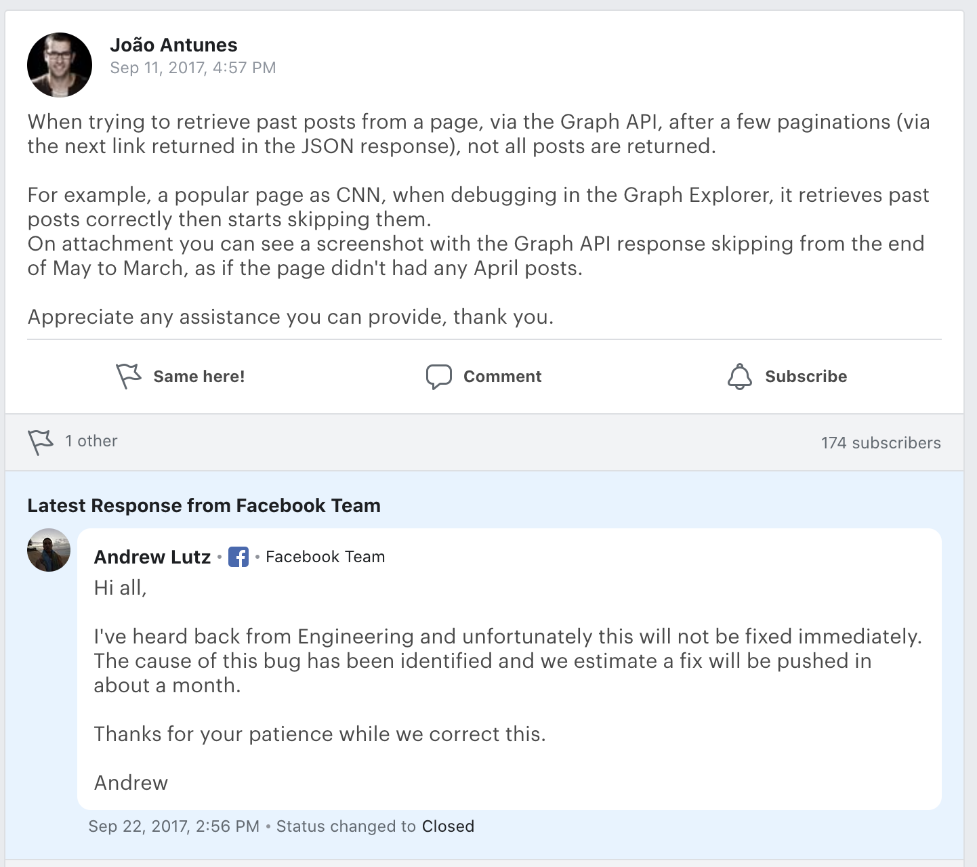
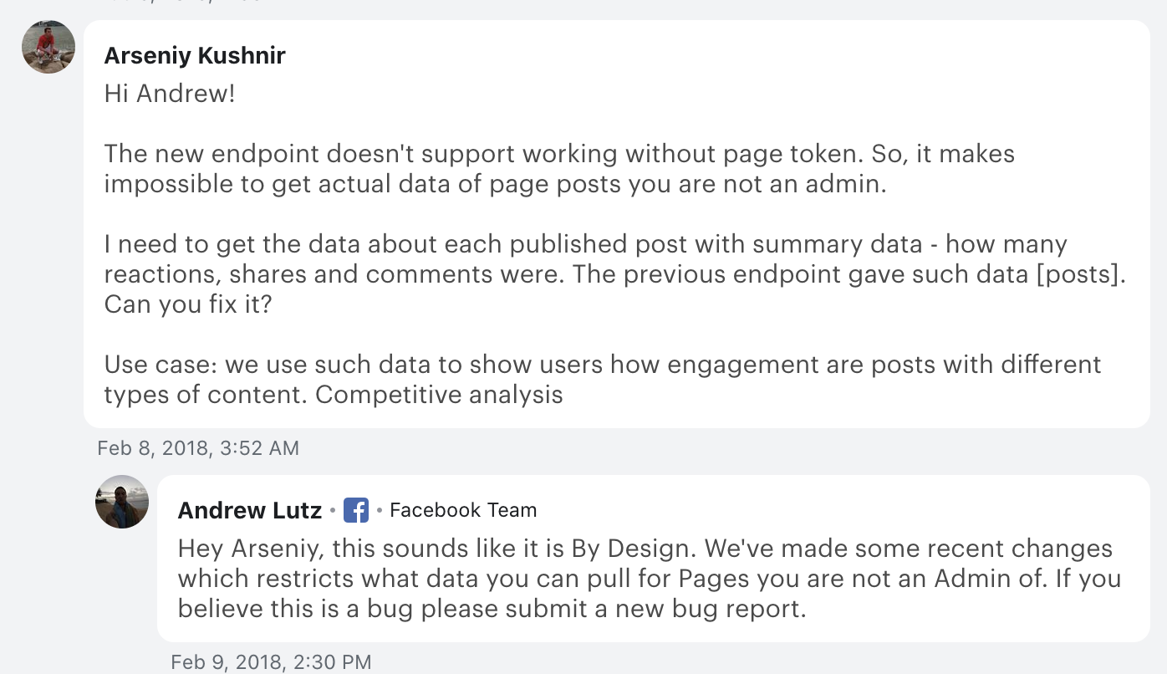
Facebook APIs only provide recent posts data
https://developers.facebook.com/support/bugs/1838195226492053/
CS895 “Co-opting of #SaveTheChildren” a study by Udith Prabhu #cs895f20

Slide 9
8 mementos found for the hashtag search on Facebook
> curl -s http://memgator.cs.odu.edu/timemap/link/https://www.facebook.com/hashtag/savethechildren | grep datetime | awk '{print $1}' | awk -v FS=/ '{print $3}' | sort | uniq -c | sort -nr
5 web.archive.org
2 archive.md
1 wayback.archive-it.org
CS895 “Co-opting of #SaveTheChildren” a study by Udith Prabhu #cs895f20

Slide 10
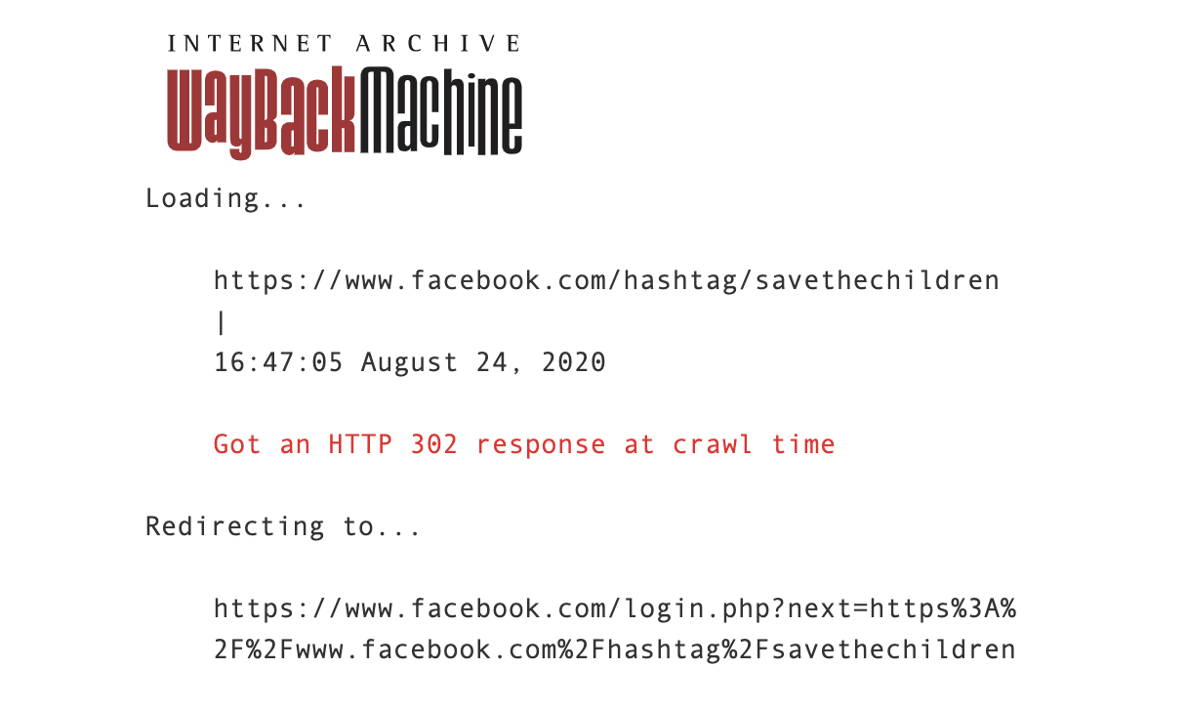
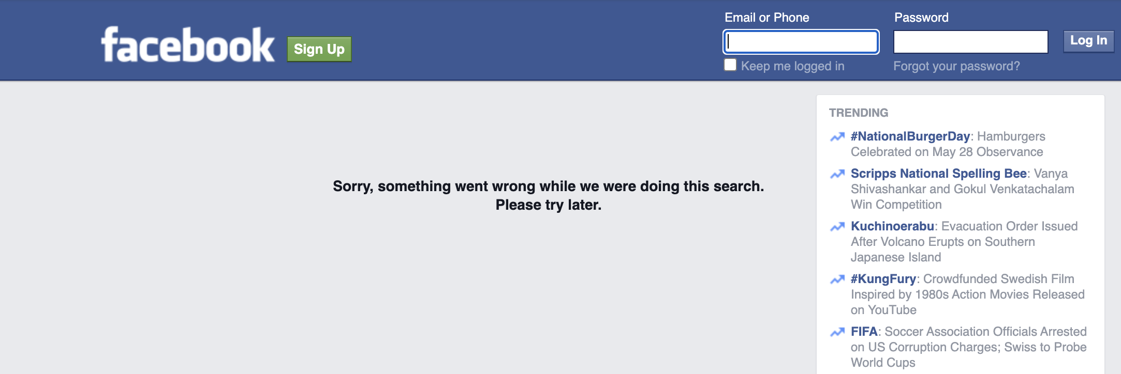
Most of the pages were not archived properly
https://web.archive.org/web/20150529081102/https://www.facebook.com/hashtag/savethechildren
https://web.archive.org/web/20200825004734/https://www.facebook.com/hashtag/savethechildren
CS895 “Co-opting of #SaveTheChildren” a study by Udith Prabhu #cs895f20

Slide 11
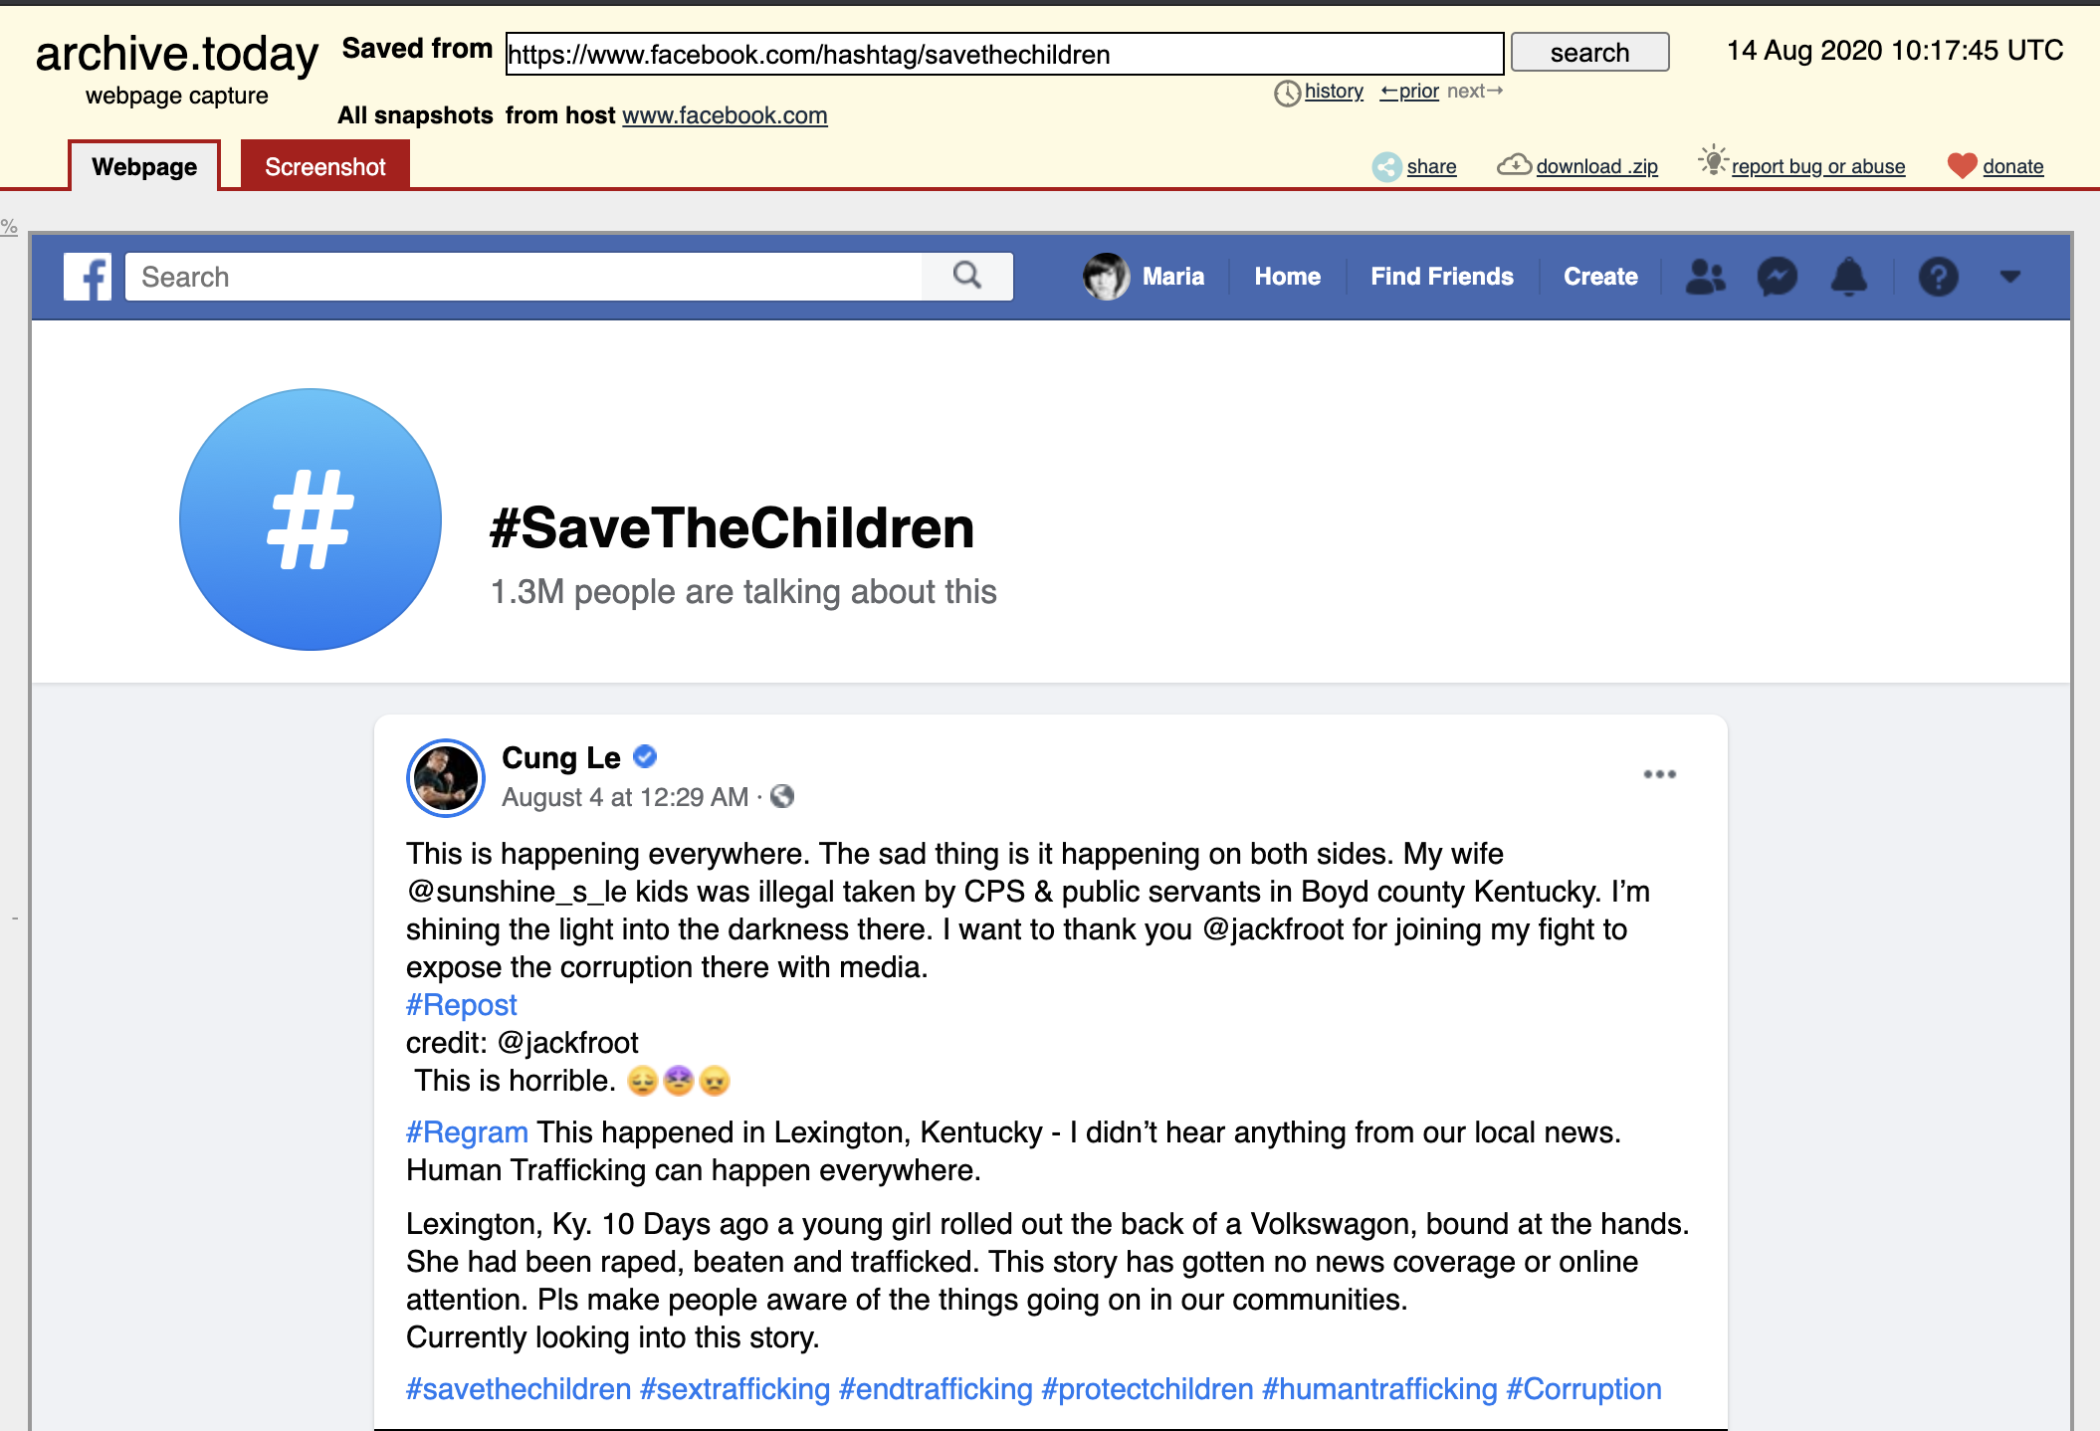
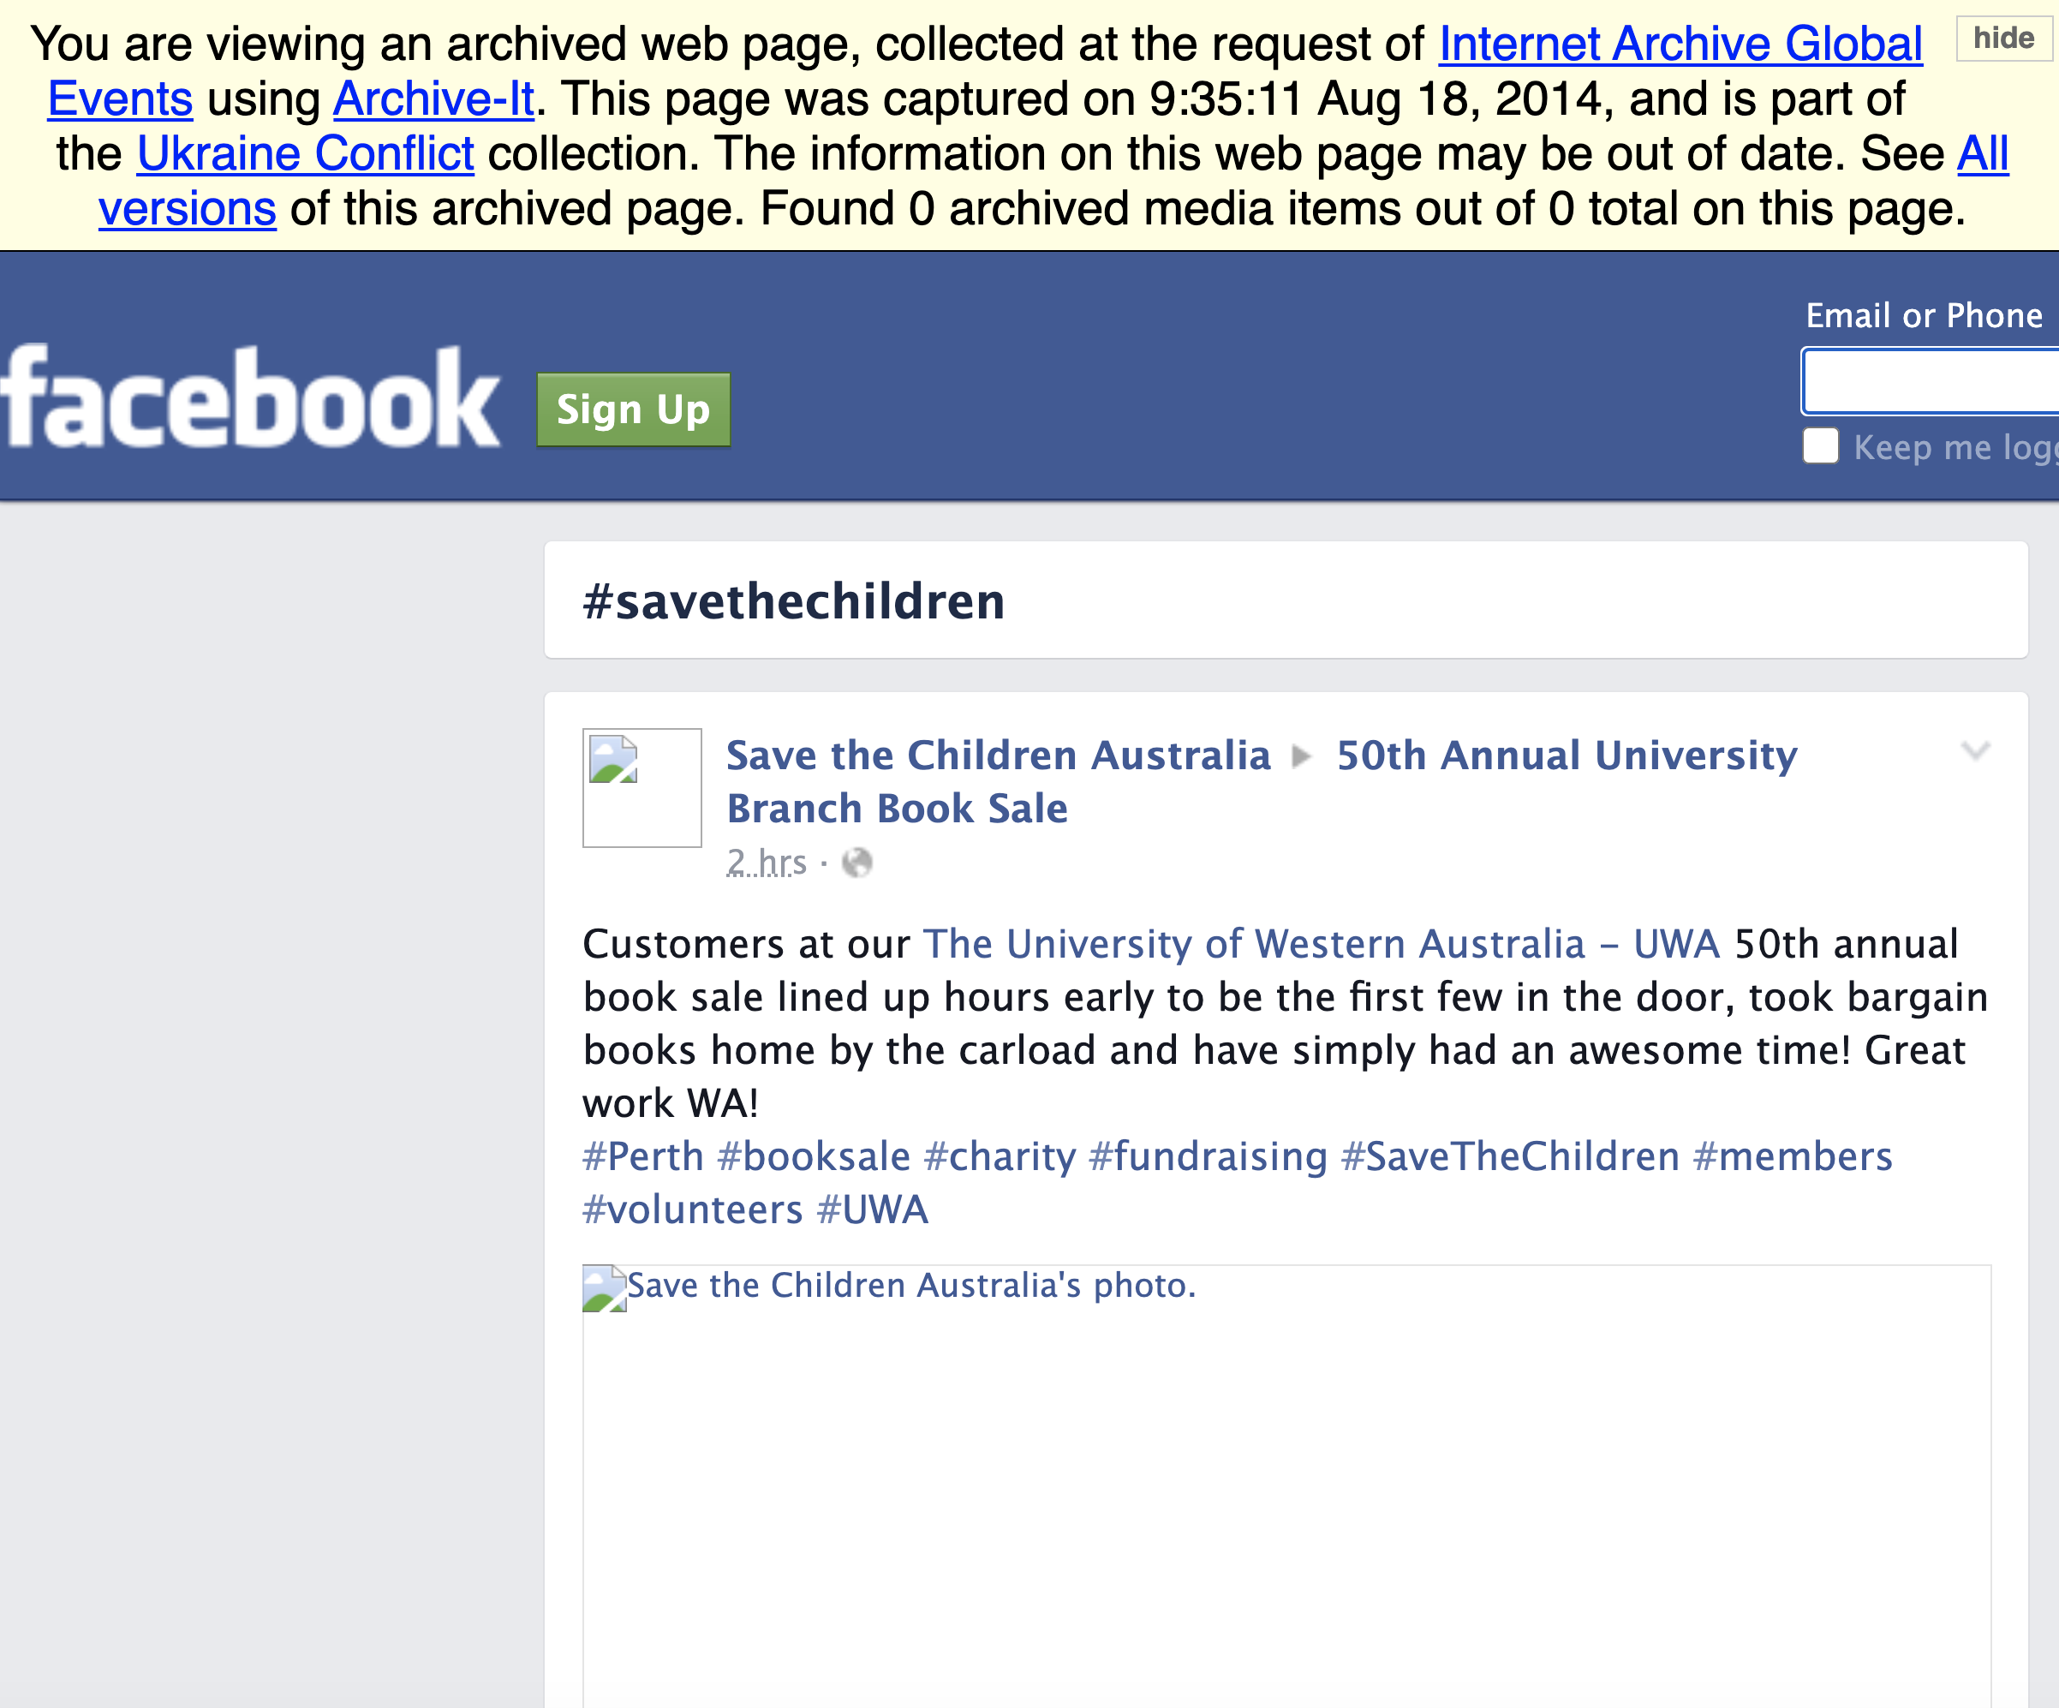
Only 2 pages from the archives had the correct content
http://archive.md/7I8hP
http://wayback.archive-it.org/all/20140818093511/https://www.facebook.com/hashtag/savethechildren
CS895 “Co-opting of #SaveTheChildren” a study by Udith Prabhu #cs895f20

Slide 12
Hashtag Analysis - Instagram
CS895 “Co-opting of #SaveTheChildren” a study by Udith Prabhu #cs895f20

Slide 13
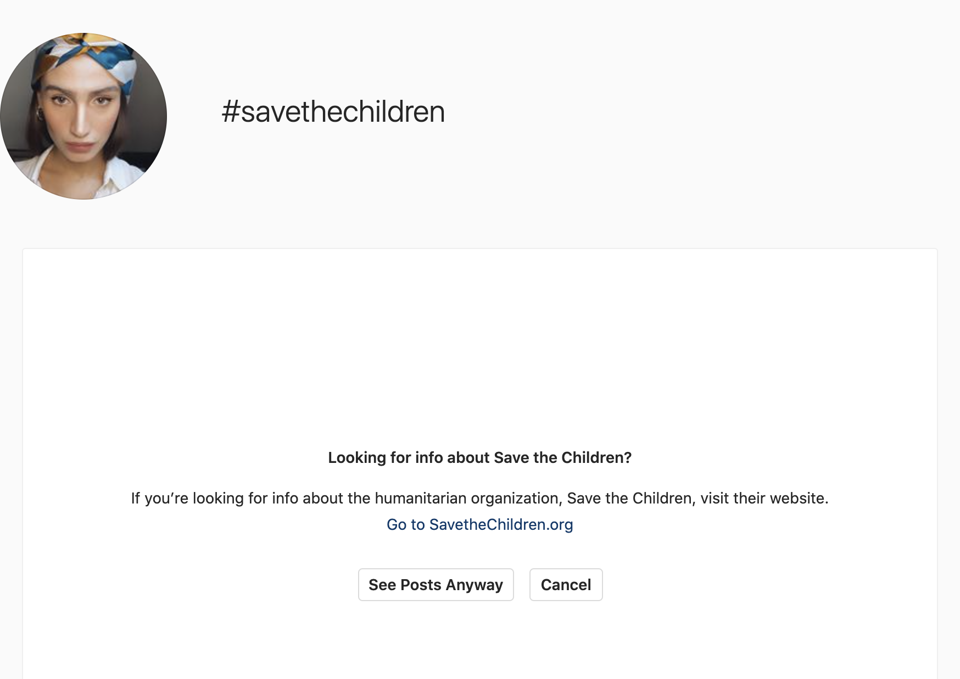
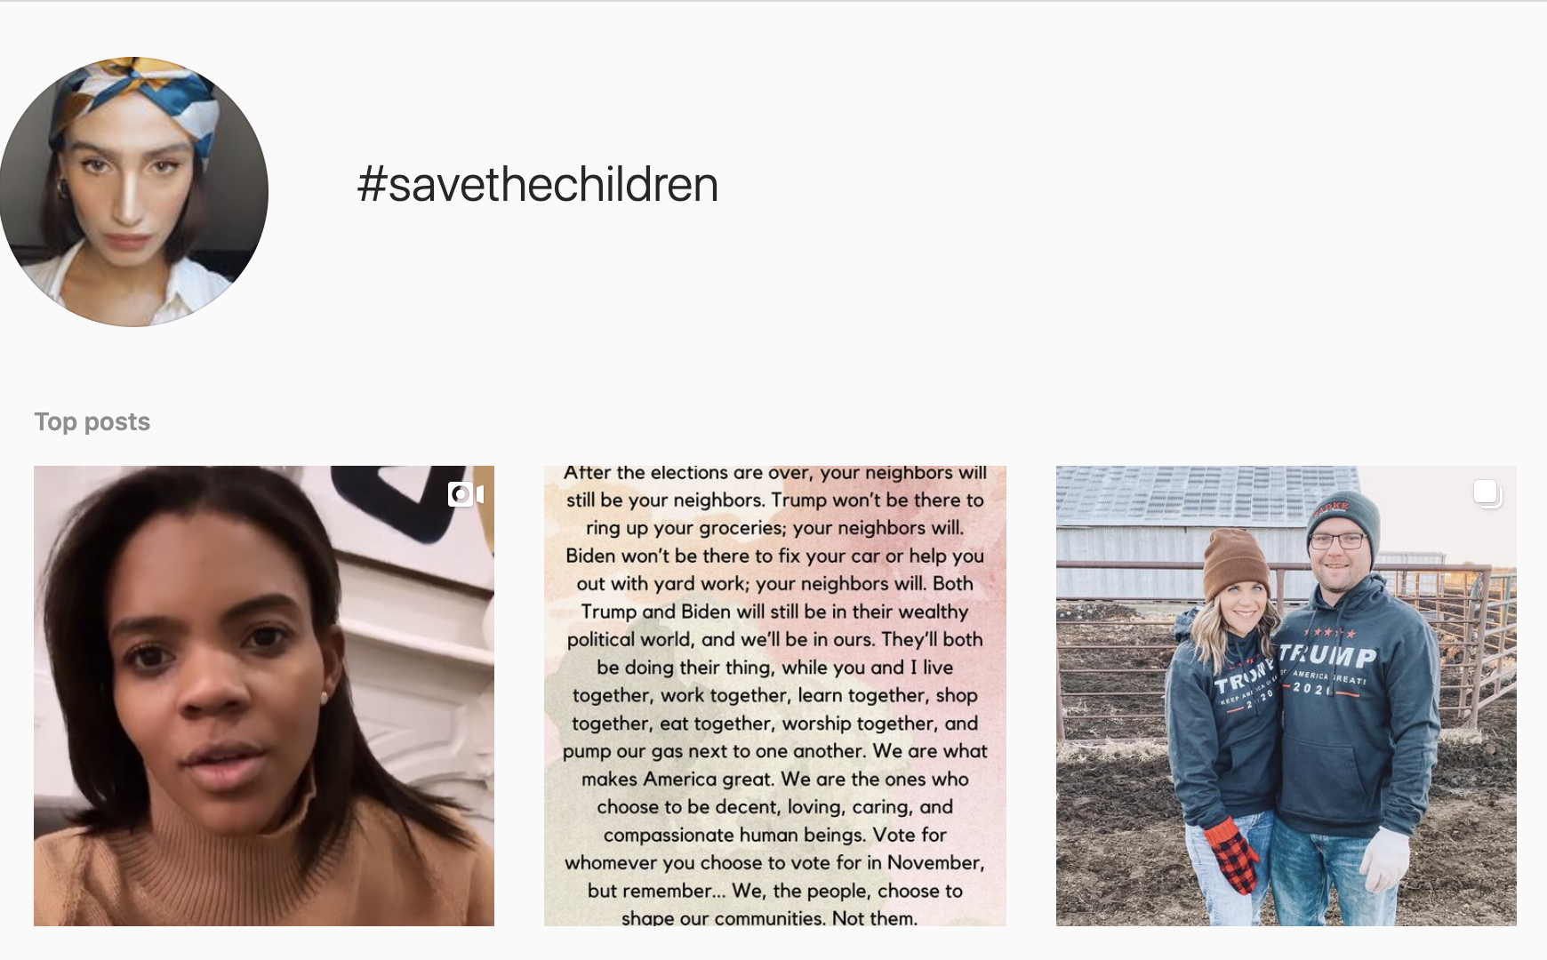
Instagram prompts confirmation first
https://www.instagram.com/explore/tags/savethechildren/
CS895 “Co-opting of #SaveTheChildren” a study by Udith Prabhu #cs895f20

Slide 14
Instagram scrapers do not give all the posts
> instaloader "#SaveTheChildren" --no-pictures --no-videos --no-video-thumbnails --no-compress-json
#savethechildren/2020-11-04_00-21-37_UTC_profile_pic.jpg
Retrieving pictures with hashtag #savethechildren...
[ 1] [HUMANITY 4 SALE Painting. Put…] json
[ 2] [Very impressive turnout for t…] json
[ 3] [Irei fazer uma bandeira igual…] json
[ 4] [#savethechildren #betheirvoic…] json
[ 5] [Don’t forget: While we are pl…] json
[ 6] [When your base consists of ha…] json
[ 7] [“I’m competitive, and I love …] json
[ 8] [#savethechildren #voteblue #b…] json
>
CS895 “Co-opting of #SaveTheChildren” a study by Udith Prabhu #cs895f20

Slide 15
Instagram page is only archived in the Internet Archive
> curl -s http://memgator.cs.odu.edu/timemap/link/https://www.instagram.com/explore/tags/savethechildren/ | grep datetime | awk '{print $1}' | awk -v FS=/ '{print $3}' | sort | uniq -c | sort -nr
54 web.archive.org
>
CS895 “Co-opting of #SaveTheChildren” a study by Udith Prabhu #cs895f20

Slide 16
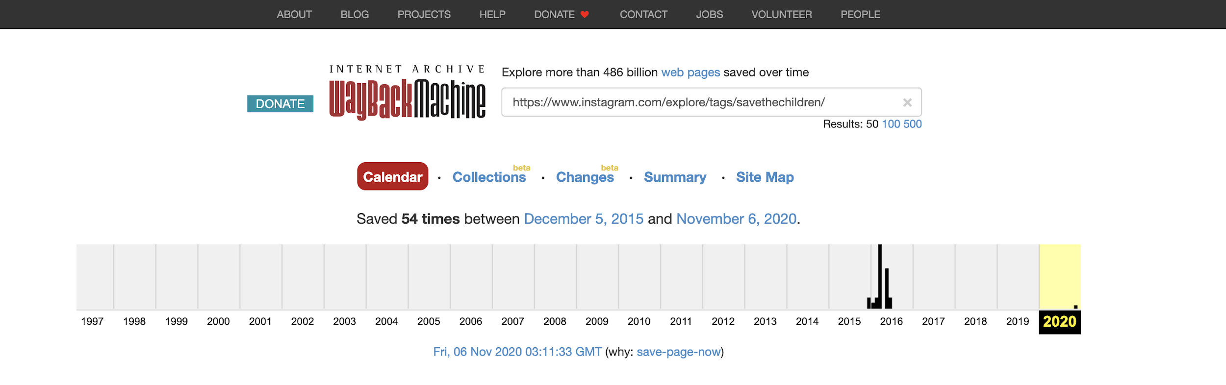
Instagram page not archived recently
http://web.archive.org/web/*/https://www.instagram.com/explore/tags/savethechildren/
CS895 “Co-opting of #SaveTheChildren” a study by Udith Prabhu #cs895f20

Slide 17
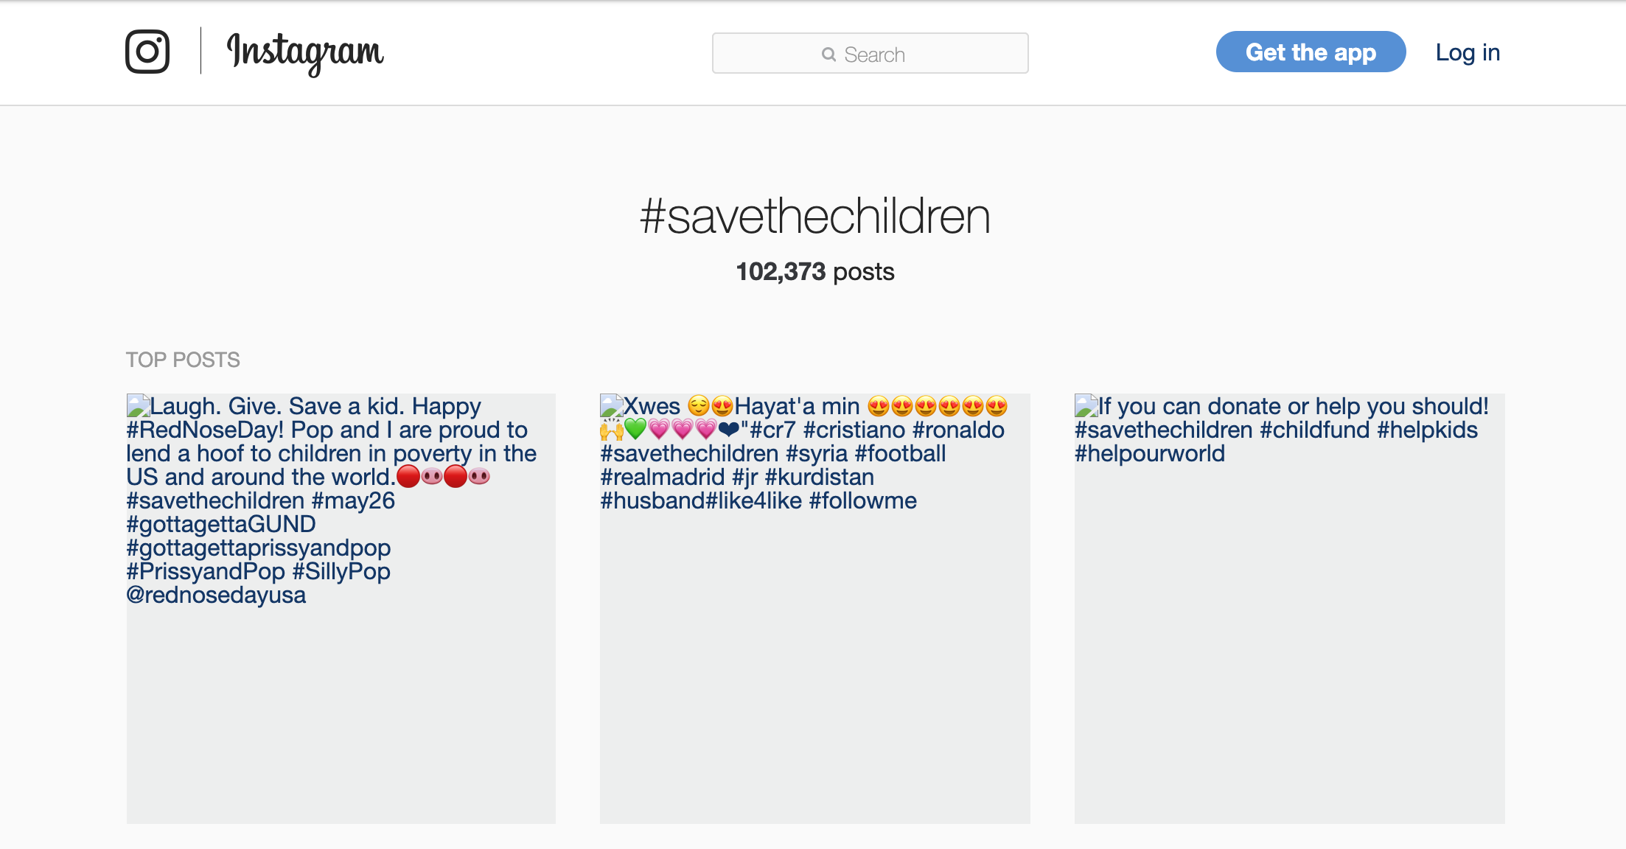
Instagram page not archived completely
http://web.archive.org/web/20160527085024if_/https://www.instagram.com/explore/tags/savetheChildren/
CS895 “Co-opting of #SaveTheChildren” a study by Udith Prabhu #cs895f20

Slide 18
Hashtag Analysis - Twitter
CS895 “Co-opting of #SaveTheChildren” a study by Udith Prabhu #cs895f20

Slide 19

#SaveTheChildren has been de-indexed on Twitter
https://twitter.com/search?q=%23SaveTheChildren&src=typed_query&f=live
CS895 “Co-opting of #SaveTheChildren” a study by Udith Prabhu #cs895f20

Slide 20
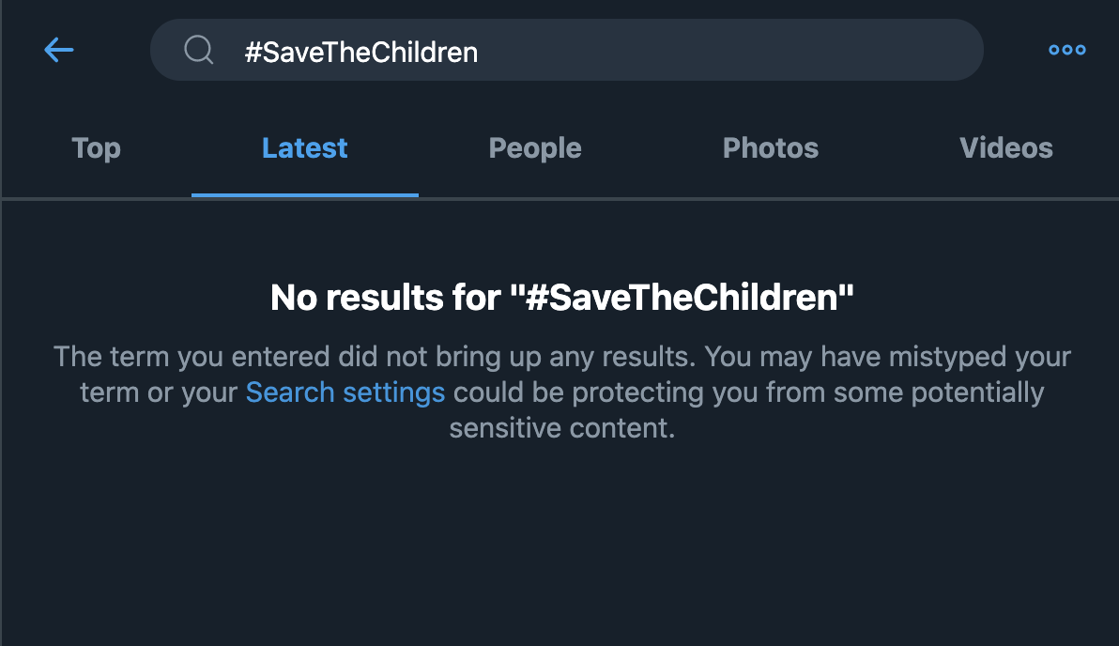
No tweets displayed for the hashtag
https://twitter.com/search?q=%23SaveTheChildren&src=typed_query&f=live
CS895 “Co-opting of #SaveTheChildren” a study by Udith Prabhu #cs895f20

Slide 21

User search is correctly displaying the results
https://twitter.com/search?q=%23SaveTheChildren&src=typed_query&f=live
CS895 “Co-opting of #SaveTheChildren” a study by Udith Prabhu #cs895f20

Slide 22
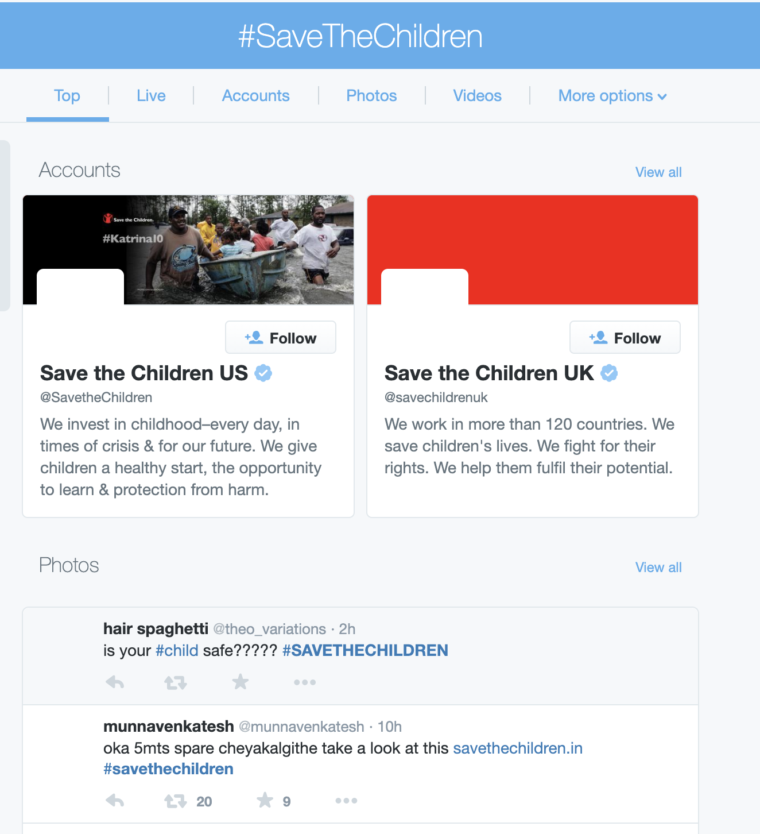
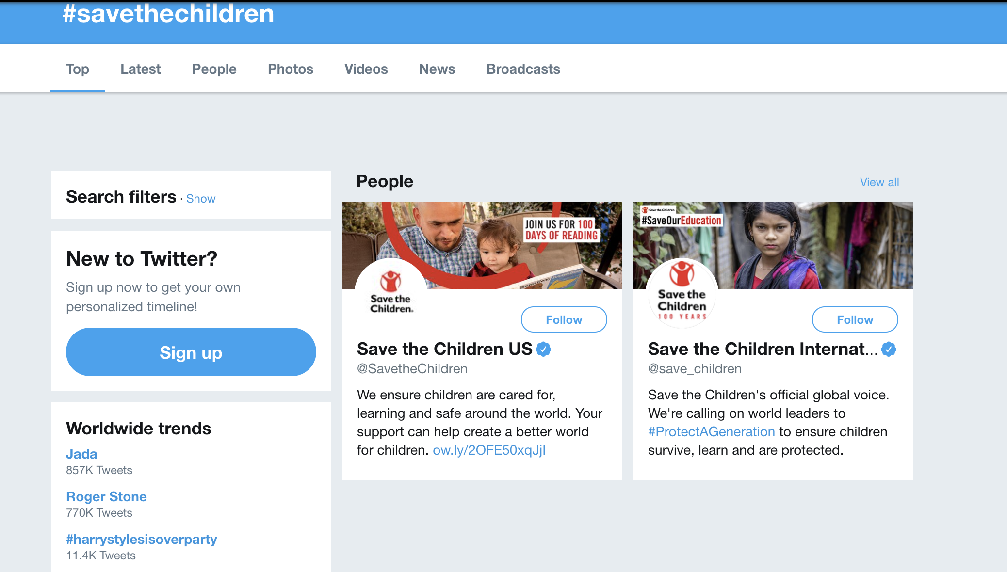
Pre vs. Post ban
(LEFT) http://web.archive.org/web/20150823034344/https://twitter.com/search?q=%23SaveTheChildren
(TOP) http://web.archive.org/web/20200801114556/https://twitter.com/search?q=%23SaveTheChildren
CS895 “Co-opting of #SaveTheChildren” a study by Udith Prabhu #cs895f20

Slide 23
Both official and unofficial scraping methods do not give results
Official Method
Unofficial Method
import tweepy
consumer_key = ''
consumer_secret = ''
access_token = ''
access_token_secret = ''
auth = tweepy.OAuthHandler(consumer_key, consumer_secret)
auth.set_access_token(access_token, access_token_secret)
api = tweepy.API(auth,wait_on_rate_limit=True)
c = len(tweepy.Cursor(api.search,q="#SaveTheChildren").items())
print(c)
> 0
import twint
config = twint.Config()
config.Search = “#SaveTheChildren”
config.Hide_output = True
config.Pandas = True
twint.run.Search(config)
df = twint.storage.panda.Tweet_df
print(df.shape[0])
> 0
CS895 “Co-opting of #SaveTheChildren” a study by Udith Prabhu #cs895f20

Slide 24
Internet Archive and Archive-IT have most number of mementos for Twitter hashtag #SaveTheChildren
> curl -s http://memgator.cs.odu.edu/timemap/link/https://www.twitter.com/hashtag/savethechildren | grep datetime | awk '{print $1}' | awk -v FS=/ '{print $3}' | sort | uniq -c | sort -nr
39 web.archive.org
23 wayback.archive-it.org
5 www.webarchive.org.uk
1 webarchive.loc.gov
CS895 “Co-opting of #SaveTheChildren” a study by Udith Prabhu #cs895f20

Slide 25
1194 mementos of the Twitter search found using memento and CDX API search on the Internet Archive and Archive-IT
> curl -s http://memgator.cs.odu.edu/timemap/link/https://www.twitter.com/hashtag/savethechildren* | grep datetime | awk '{print $1}' | awk '{print substr($0, 2, length($0)-3)}' > urls.txt
> curl -s "http://web.archive.org/cdx/search/cdx?url=https://www.twitter.com/hashtag/savethechildren&matchType=prefix" | awk '{print "http://web.archive.org/web/" $2 "/" $3}' >> urls.txt
> cat urls.txt | wc -l
1194
> cat urls.txt | head -n 5
https://wayback.archive-it.org/all/20140603145110/https://twitter.com/hashtag/SavetheChildrenEast?src=hash
https://wayback.archive-it.org/all/20140603145111/https://twitter.com/hashtag/SavetheChildrenEast
https://www.webarchive.org.uk/wayback/archive/20140616021825mp_/https://twitter.com/hashtag/savethechildren
https://wayback.archive-it.org/all/20140703172422/https://twitter.com/hashtag/SaveTheChildren?src=hash
https://wayback.archive-it.org/all/20140703172424/https://twitter.com/hashtag/savethechildren
CS895 “Co-opting of #SaveTheChildren” a study by Udith Prabhu #cs895f20

Slide 26
7009 tweets found in the archived pages
> python3 getTweets urls.txt > prettyPrintedTweets.txt
> cat prettyPrintedTweets.txt | head -n 5
marina_saniram : Slavyansk kids escape to Russia from Kiev’s shelling http://rt.com/ne..
marina_saniram : #Slavyansk Night in the basement pic.twitter.com/KVHf1QUykh #SaveDonb..
marina_saniram : Slavyansk kids escape to Russia from Kiev’s shelling http://rt.com/ne..
marina_saniram : #Slavyansk Night in the basement pic.twitter.com/KVHf1QUykh #SaveDonb..
PaganSoul366 : This isn't about immigration...This is about refugees! #SaveTheChildr..
JolieSchwarz : Wishing this http://goo.gl/OIg5OD for all mothers escaping violence a..
erazo_ruth : "Just because it isn't happening here doesn't mean it isn't happening...
stc_de : Heute ist @SozialerTag! Gefördert wird unter anderem ein #Savethechild..
KarisBoyne : That guilty feeling in the pit of your stomach you get when an ad for ..
IliasBey : Twitter / IliasBey: #Savethechildren #Empowertheyouth ... http://fb.me..
> cat prettyPrintedTweets.txt | wc -l
7009
CS895 “Co-opting of #SaveTheChildren” a study by Udith Prabhu #cs895f20

Slide 27
1232 unique users
> cat prettyPrintedTweets.txt | awk ‘{ print $1 }’ | sort | uniq | wc -l
1232
> cat prettyPrintedTweets.txt | awk ‘{ print $1 }’ | sort | uniq | head -n 5
01nv1s1ble1
10Hercules10
10thAmendment
15minutosnews
1957_Tintin_
CS895 “Co-opting of #SaveTheChildren” a study by Udith Prabhu #cs895f20

Slide 28
10 accounts that most tweeted the hashtag
> cat prettyPrintedTweets.txt | awk ‘{ print $1 }’ | sort | uniq -c | sort -nr | head -n 10
141 StopTrump2020
98 SMonitors
92 Khaleesi1021
90 Cornishview
88 RevJJackson
60 Socratic1
60 LakotaMan1
59 SaveChildrenPE
58 Helenhs
57 prayingmedic
CS895 “Co-opting of #SaveTheChildren” a study by Udith Prabhu #cs895f20

Slide 29
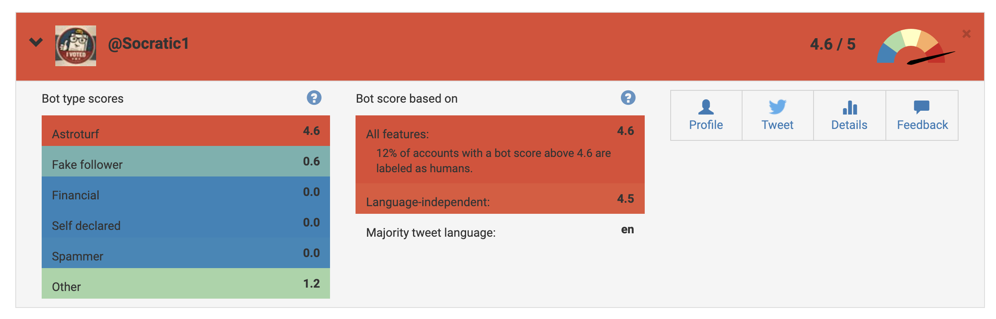
Botometer report for one of the accounts
https://botometer.osome.iu.edu/
CS895 “Co-opting of #SaveTheChildren” a study by Udith Prabhu #cs895f20

Slide 30
2 of the accounts are most likely bots and 1 account is suspended
User | Bot Rating ( Out of 5 ) | Note
StopTrump2020 | 1
SMonitors | 0.7
Khaleesi1021 |  | Account Suspended
Cornishview | 0.6
RevJJackson | 1.8 | Verified Account
Socratic1 | 4.6 | Most likely a bot
LakotaMan1 | 0.2
SaveChildrenPE | 2.3 | Verified Account
Helenhs | 4.4 | Most likely a bot
prayingmedic | 2
CS895 “Co-opting of #SaveTheChildren” a study by Udith Prabhu #cs895f20

Slide 31
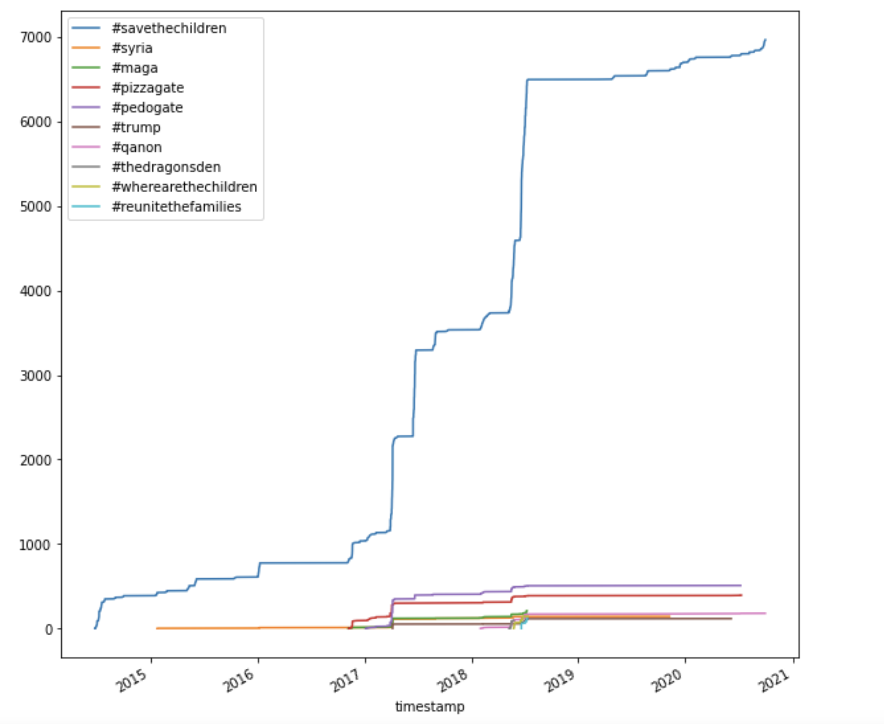
Malicious hashtags started accompanying #savethechildren from as early as 2017
CS895 “Co-opting of #SaveTheChildren” a study by Udith Prabhu #cs895f20

Slide 32
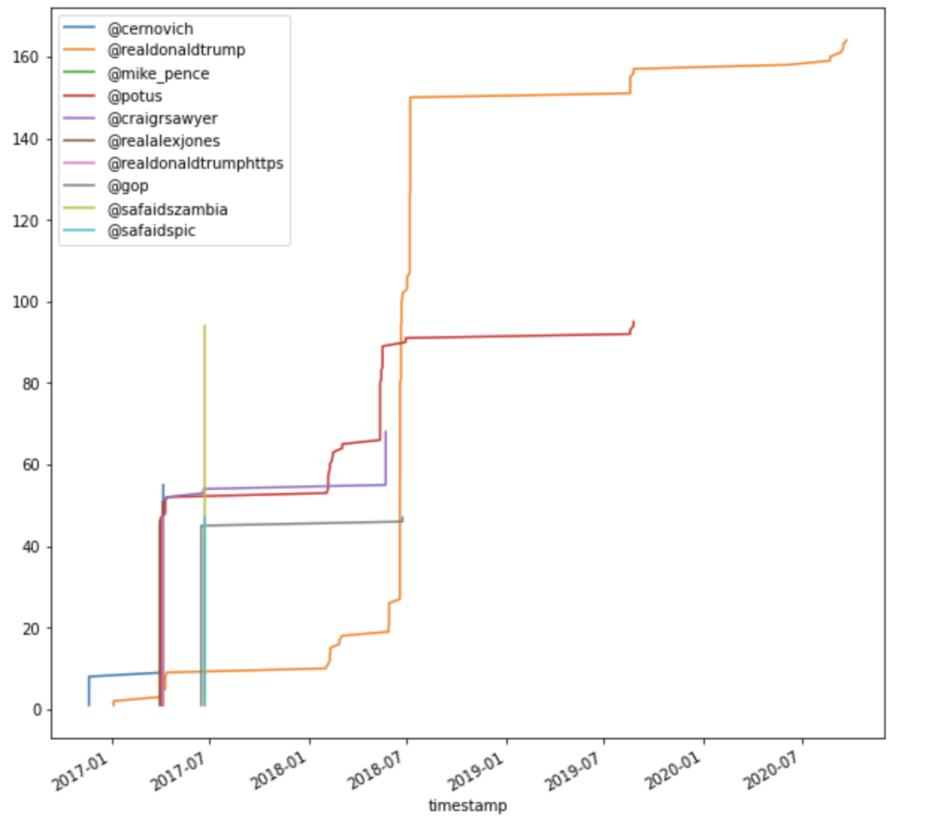
Unrelated users were tagged to the tweets
CS895 “Co-opting of #SaveTheChildren” a study by Udith Prabhu #cs895f20

Slide 33
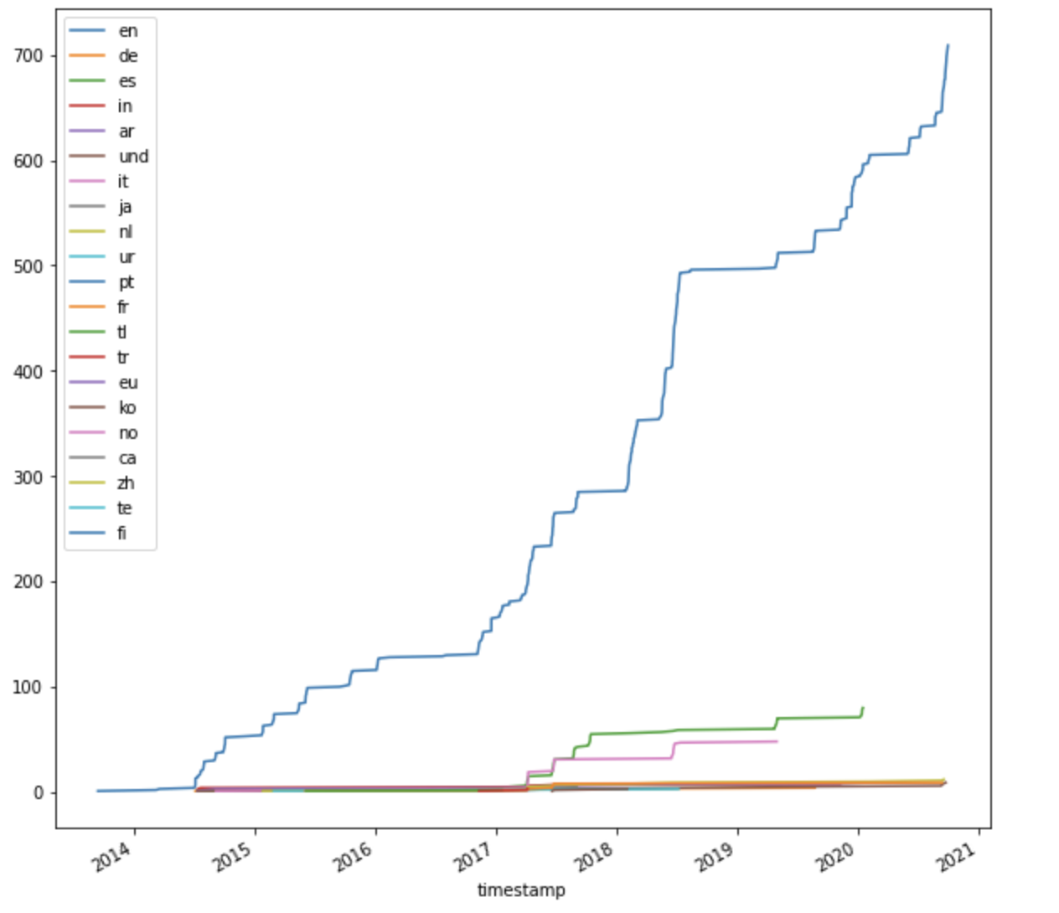
Suspicious increase of tweets in Spanish and Italian around 2017
CS895 “Co-opting of #SaveTheChildren” a study by Udith Prabhu #cs895f20

Slide 34
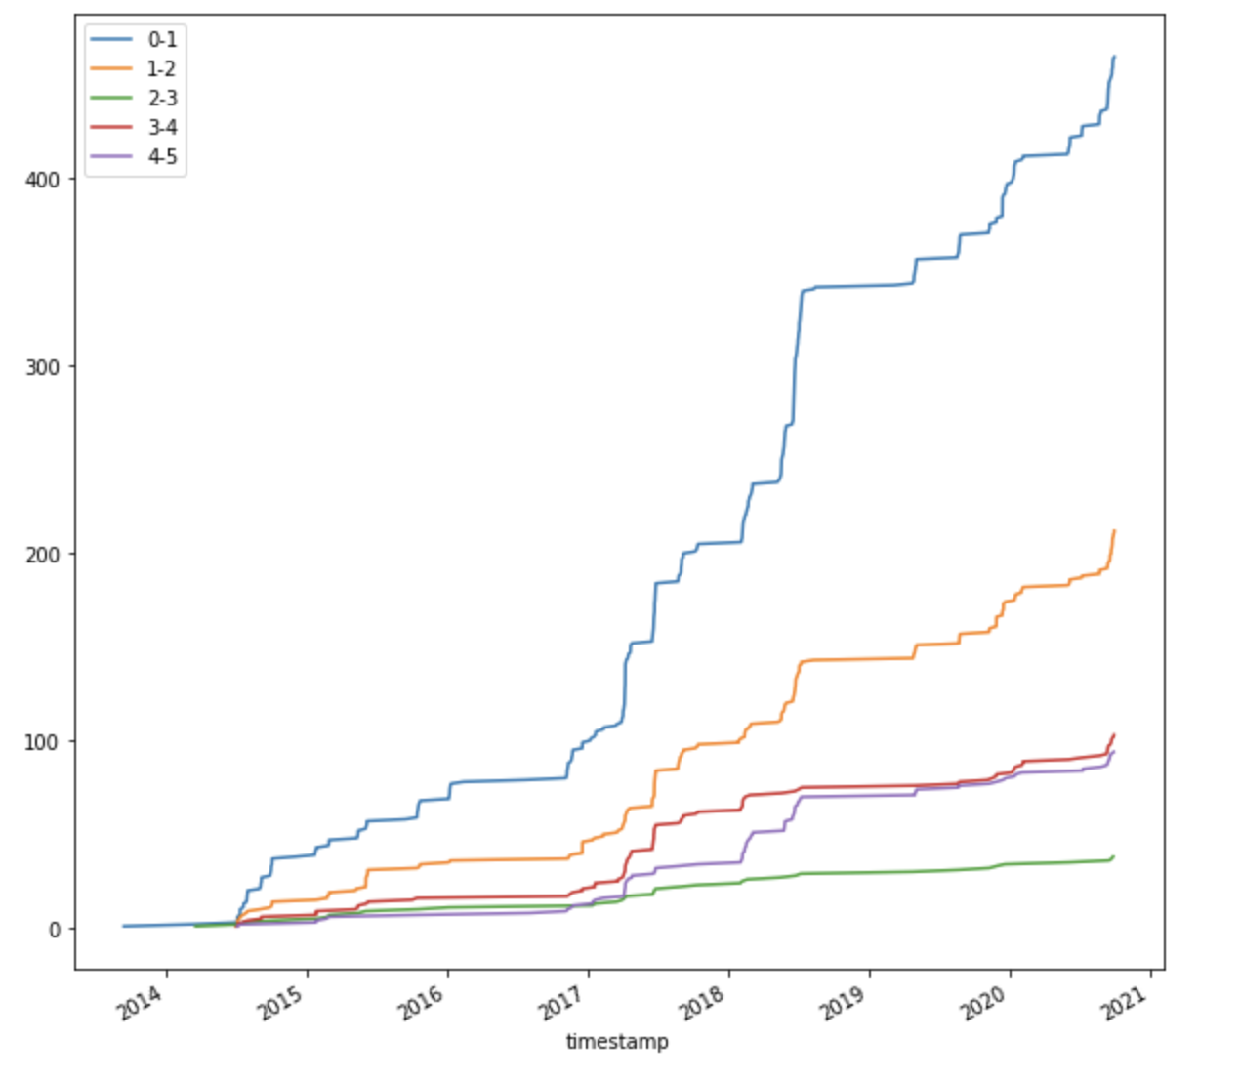
Minimal increase in Bot activity around 2017
CS895 “Co-opting of #SaveTheChildren” a study by Udith Prabhu #cs895f20

Slide 35
Key Takeaways
The hashtag #SaveTheChildren was co-opted by a domestic terrorist group known as QAnon
Multiple social networking sites have worked to prevent the spread of misinformation from this group.
This ban was brought about only recently, between August 15 and October 29.
Archives show us that the co-opting might have had pre-planning as we see an increase in spurious activities surround the hashtag around the beginning of 2017
The attack in 2017 involved non-English accounts. This might have been done to avoid scrutiny.
Bots might not have played an important role in the 2017 attack as there was no sudden increase in bot activity.
CS895 “Co-opting of #SaveTheChildren” a study by Udith Prabhu #cs895f20

